Slide 1

nmrML: Standing on the shoulders of Giants
Leibniz-Institut für Pflanzenbiochemie
Daniel Schober, IPB Halle
for COSMOS WP 2

Slide 2
Outline
Challenges in metabolomics data storage, retrieval & mining
Introduction to nmrML
XSD
Controlled Vocabularies / Ontologies
Inhouse data example
Conclusions

Slide 3
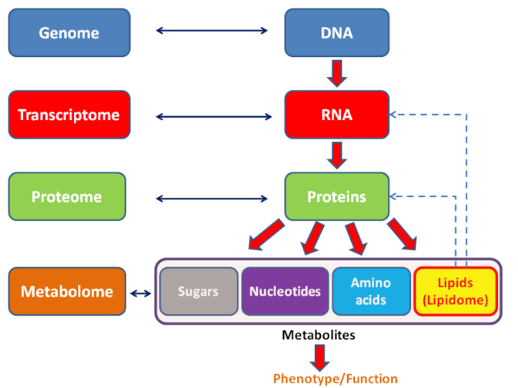
Metabolomics
MS & NMR

Slide 4
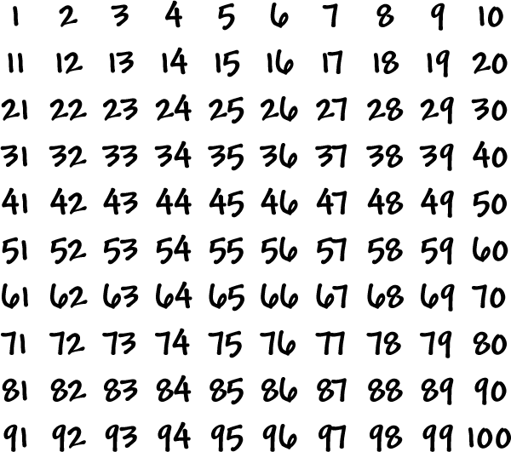

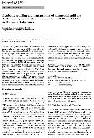
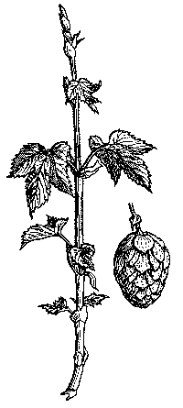

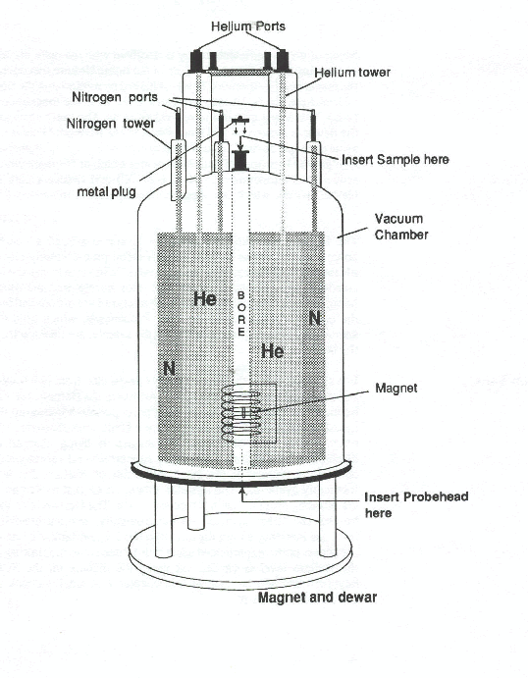
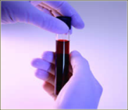
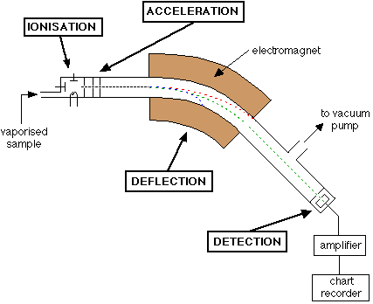

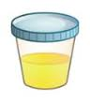
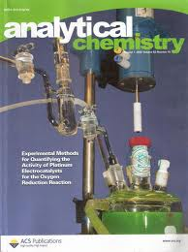
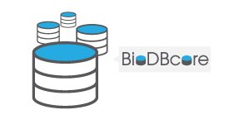
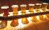

Need for reporting standards
Metabolomics workflow
Wet laboratory
Bioinformatics
Publication
Data storage, analysis
& interpretation
Sample collection
Assay: NMR, MassSpec, …
Findings
Data
Local inhouse management &
long term storage
Standard Needed !
Diverse technologies, parameters & data formats
Vendor formats are incompatible, verbose & hard to interpret
Data silos with restricted access
→ Need for open standard for robust data storage, sharing, retrieval & interpretation

Slide 5
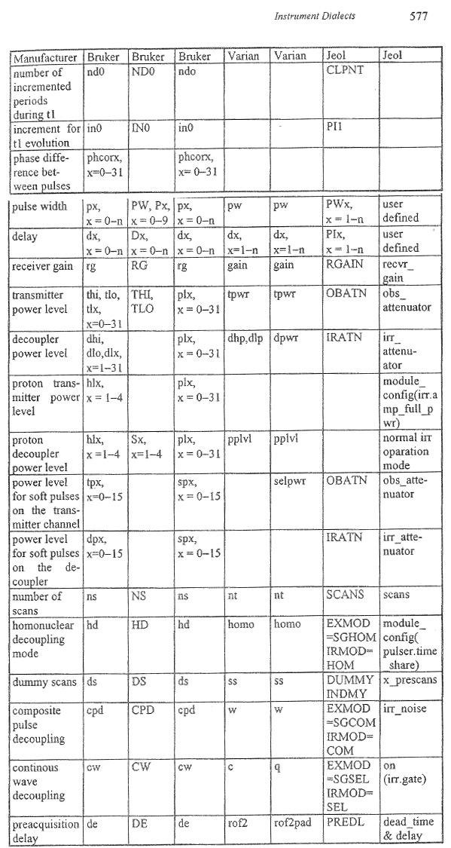
NMR formats
Variety in
parameters & vendor formats
Many synonyms:
relaxation delay, dx, PIx

Slide 6

Synonyms for ‚Irradiation Frequency‘ in NMR
„Nmr frequency“
„electromagnetic excitation“
„nuclei irradiation“
<xs:element name="irradiationFrequency" type="ValueWithUnitType"> </xs:element>

Slide 7

nmrML requirements http://cosmos-fp7.eu
Vendor-neutral open exchange & storage format
Understood by open tools & public repositories
Standard to facilitate data mining & reuse
Using ontology for synonym-convergence & homonym- resolution
Human & computer readable
Like mzML for Mass Spectrometry

Slide 8


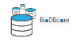

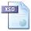




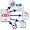


nmrML usage & implementation
coordinates
Open NMR Format
EU 7th FP
nmrML.xsd
Data Repositories
Persistent storage
nmrML combines XML elements
with controlled terms
in one XML file
Global
nmrCV.owl
MetaboLights
Local
Data Processing
Format Conversion
Semantic Validators
Parsers for vendor formats
JCampDX
Open NMR Tools
MetaboQuant

Slide 9
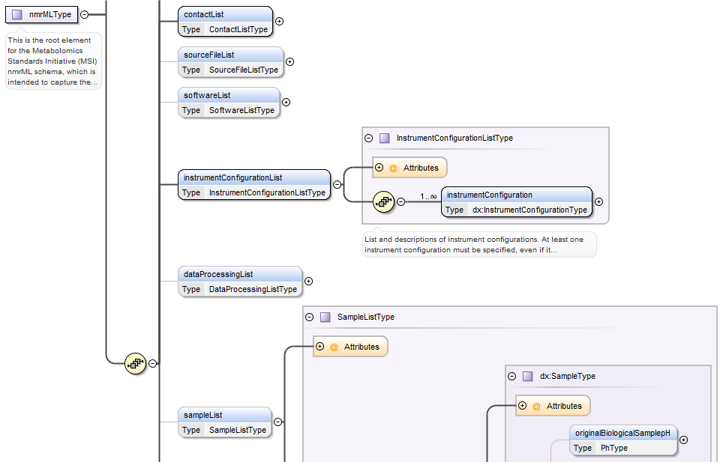
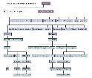

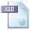
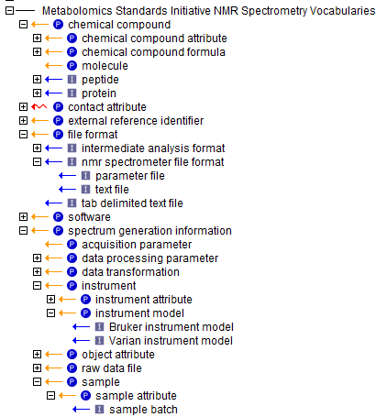
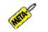
Components:
nmrML combines XML elements and
controlled terms from ontology with in one XML file
xsd elements
& attributes
xsd datatypes
nmrCV terms

Slide 10

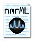



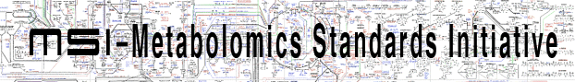


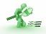

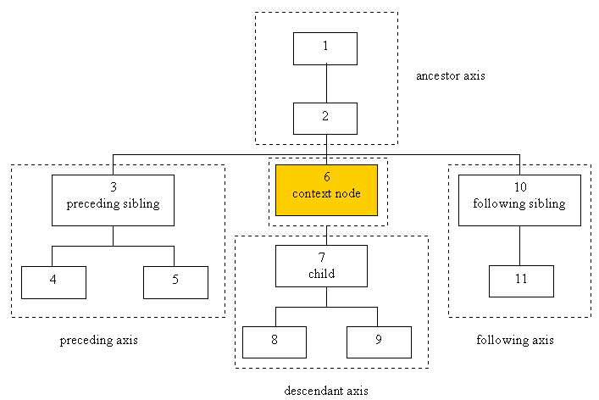


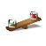

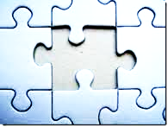

COSMOS data annotation, verification, and distribution workflow (sine semantic web)
Standards deployment
Standards development
nmrML instance
(Storage & exchange syntax)
constraints
nmrML
approves
guided
data submission
provides terms
nmrCV
serves
MetaboLights
queries
Persistent
Storage Format
Semantic Validator
used in
Rules & X Path
validates
ensures
Tools
parse
Open Formats
JCampDX
MetaboQuant
support
Converters
support
Validity, compatibility, completeness

Slide 11

The data landscape
Raw data (FID)
Pre-processing
-FFT, LB, phasing
nmrML (XSD)
1R raw spectrum
Post-processing
-baseline Correction
-Noise reduction
-alignment
nmrCV
1R cleaned spectrum
ISA-Tab
MetaboLights:
Protocols
&
Assays
Binning / Deconvolution
Peaks List / Patterns
Identification
Quantification
Chemical Compounds
Quantifications
nmrTab

Slide 12
Competency Questions (CQ)
Competency Questions for nmrCV & nmrML only
Get all spectra on 500Mz Bruker machine that do 1D H+ Spectra (on Human Urine samples for doping chemicals)
Get spectra generated via Bruker CryoProbe and D2O solvent
What samples with certain pH range
Get spectra according to decoupling method
Get spectra that were generated via open source nmr software
Get nmr Spectra that have been FT transformed and were smoothed via Gaussian smoothing
Show me reference spectra for xyz compound
What spectra used flow high resolution probe in the instrument?
CQ for nmrCV and IdentML CV
Get 1D spectra with doublets in ppm range x to y
Show me nmr spectra for changes in metabolites involved in Citrate Circle after Fat consumption in Human
How does the aromatic amino acid fraction differ in Hop plant variants ?
E.g. look at http://omiabis-dev.googlecode.com/svn/branches/CompetencyTest.owl

Slide 13
nmrML example
The Full Monty
<nmrML xmlns="http://nmrml.org/schema"
xmlns:xsi="http://www.w3.org/2001/XMLSchema-instance"
xsi:schemaLocation="http://nmrml.org/schema ../../../xml-schemata/nmrML.xsd"><!--add version attribute -->
<cvList><!--add count attribute -->
<cv fullName="nmrML Controlled Vocabulary" version="0.0.1" id="ID001"<!--put NMRCV --> URI="http://www.nmrml.org/nmrml-cv.0.0.1.owl"/>
<cv fullName="Unit Ontology" version="3.2.0" id="ID002" URI="http://unit-ontology.googlecode.com/svn/trunk/uo.owl/"/>
</cvList>
<fileDescription>
<fileContent>
<cvTerm cvRef="NMRCV" accession="NMR:1400159" name="1D FID"/>
</fileContent>
</fileDescription>
<contactList>
<contact id="ID004" fullname=“Andrea Porzel" email="aporzel@ipb-halle.de"/>
</contactList>
<sourceFileList>
<sourceFile
="e4ffeb41da28b1e9017e72819252ec6d78f8179f"
location="file:///Users/mike/Projects/nmrML/nmrML/examples/IPB_HopExample/FIDs/FAM013_AHTM.PROTON_04.fid/fid"
id="SOURCE_FILE_1" name="fid">
<cvTerm cvRef="NMRCV" accession="NMR:1400119" name="FID file"/>
<cvTerm cvRef="NMRCV" accession="NMR:1400297" name="Varian VNMR Format"/>
</sourceFile>
<sourceFile sha1="fd99c095046e2356c7d31154d45353fa79cbc844“
location=file:///Users/mike/Projects/nmrML/nmrML/examples/IPB_HopExample/FIDs/FAM013_AHTM.PROTON_04.fid/procpar
id="SOURCE_FILE_2" name="procpar">
<cvTerm cvRef="NMRCV" accession="NMR:1002006" name="acquisition parameter file"/>
<cvTerm cvRef="NMRCV" accession="NMR:1400297" name="Varian VNMR Format"/>
</sourceFile>
</sourceFileList>

Slide 14
nmrML example
The Full Monty II
<softwareList>
<software cvRef="NMRCV" accession="NMR:1000277" name="VnmrJ software" version="2.2C" id="SOFTWARE_1"/>
</softwareList>
<instrumentConfigurationList>
<instrumentConfiguration id="INST_CONFIG_1">
<cvTerm cvRef="NMRCV" accession="NMR:400234" name="Varian NMR instrument"/>
<cvTerm cvRef="NMRCV" accession="??" name="Varian VNMRS 600 NMR spectrometer"/>
<userParam name="5 mm inverse detection cryoprobe"/>
</instrumentConfiguration>
</instrumentConfigurationList>
<acquisition>
<acquisition1D>
<acquisitionParameterSet numberOfScans="160" numberOfSteadyStateScans="0">
<acquisitionParameterFileRefList>
<sourceFileRef ref="SOURCE_FILE_1"/>
<sourceFileRef ref="SOURCE_FILE_2"/>
</acquisitionParameterFileRefList>
<sampleAcquisitionTemperature unitName="kelvin" unitCvRef="UO" value="299.15" unitAccession="UO:0000012"/><!--There is no ID/IDREF binding for IDREF 'UO' -->
<spinningRate unitName="hertz" unitCvRef="UO" value="0" unitAccession="UO:0000106"/>
<relaxationDelay unitName="second" unitCvRef="UO" value="22.2737024" unitAccession="UO:0000010"/>
<pulseSequence>
<cvTerm cvRef="NMRCV" accession="??" name="??"/><!--take from vendor pulse sequence lists-->
<pulseSequenceFileRefList>
<pulseSequenceFileRef ref="PULSE_SEQ_SRC"/><!--There is no ID/IDREF binding for IDREF 'PULSE_SEQ_SRC' -->
</pulseSequenceFileRefList>
</pulseSequence>
<DirectDimensionParameterSet numberOfDataPoints="65536" decoupled="true"><!--was actually not true! false! -->
<acquisitionNucleus cvRef="NMRCV" accession="NMR:1400151" name="1H"/>
<gammaB1PulseFieldStrength unitName="hertz" unitCvRef="UO" value="344827.586207" unitAccession="UO:0000106"/>
<irradiationFrequency unitName="hertz" unitCvRef="UO" value="599.8311617" unitAccession="UO:0000106"/><!--Invalid content was found starting with element '{"http://nmrml.org/schema":irradiationFrequency}'. One of '{"http://nmrml.org/schema":sweepWidth}' is expected. -->
<decouplingMethod cvRef="NMRCV" accession="NMR:1000046" name="??"/><!--delete as not decoupled, more important for 2D ? CV terms hard to define, better free text or leave out-->
</DirectDimensionParameterSet>
</acquisitionParameterSet>
<fidData byteFormat="Complex128" encodedLength="324160" compressed="true">eJwMl4dfzl8Ux7U3lYZKy0qiomQLPd9zHlmhsA=</fidData>
</acquisition1D>
</acquisition>
</nmrML>

Slide 15
Format conversions & Parser Workflows
Vendor Formats (Bruker, Varian)
ISAtab file
Bruker: D. Jacobs,
\tools\Parser_and_Converters\Java , JAXB framework (Java Architecture for XML Binding), uses luis F nmr-fid-tool API https://github.com/LuisFF/nmr-fid-tool
Varian : M. Wilson,
pynmrml, Python based, uses http://code.google.com/p/nmrglue/ to access Vendor format, creates XML bindings via generateDS.py
nmrML
Visualisations
nmr spectra viewer:
web-based, uses jQuery framework, e.g.
http://services.cbib.u-bordeaux2.fr/SPECNMR/T06002e
Data reduction:
e.g. ERVA NMR bucketing, clustering, cluster comparison …
nmrML2Tools (S. Neumann, rIO )
Other Parsers:
nmrML to MAF
nmrML to JCamp-dx
R, rNMR, Batman

Slide 16
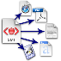




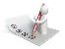

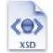


Onion model of validation layers
XML Syntax
Structural validity of nmrML XML instances
Semantic validity of CV term usage
Minimum Information Standard compliance
e.g. CIMR Core Information for Metabolomics Reporting
Journal Policy compliance

Slide 17
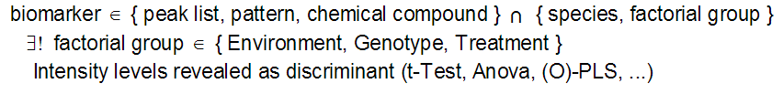
From Daniel Jacob: Queries on processed NMR Data
NMR queries concerning "biomarker"
NMR sub-queries on nmr resources (related with the above ones)
Find “peaks list” or pattern for
a specific chemical compound
a specific solvant (D2O, Methanol) and/or a specific pH
Find “chemical compounds” for
a specific peaks list or pattern
a specific solvant (D2O, Methanol) and/or a specific pH

Slide 18
Current status & outlook
First release of nmrML standard in Feb at http://nmrml.org
Minoir feedback so far…
Specification document, XSD, CV & example XML files
Good coverage on nmr raw data, less on multidimensional & processed NMR data
CV to be expanded in decentralised & data-driven manner
Validation rule set enforced on obo converted owl nmrCV via hacked OpenMS validator
Interaction with vendors
Develop NMR XML fomat
nmrML, nmrIdentML, nmrQuantML and nmrTab
Starting investigations into Linked Data realm

Slide 19
Conclusions
CopyCating PSI XML-CV architecture and re-using PSI validators is feasable to support COSMOS MSI standards
nmrML facilitates access to structured metabolomics data
Increase secondary data usage
Increase data persistence
Data quality increased by content validation
Intelligent data mining
More detailed search & more comprehensive retrieval of data
Homonym resolution, synonym coverage, generalisation, …

Slide 20
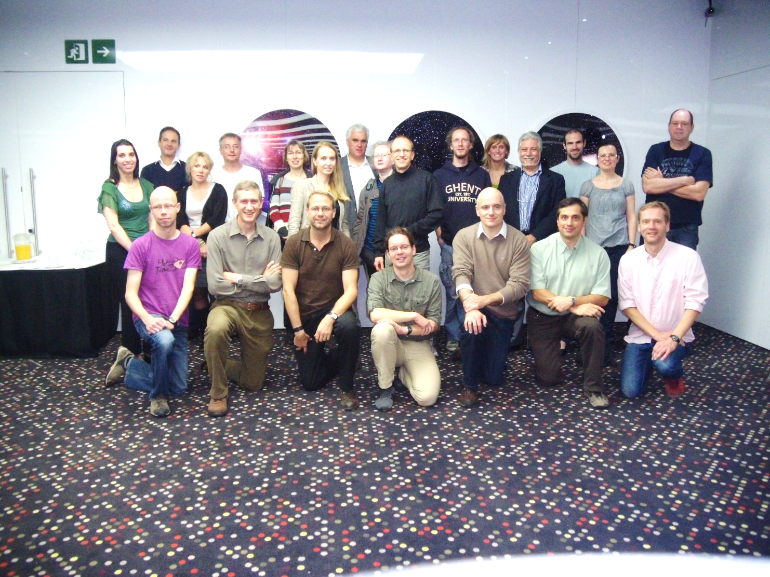

Acknowledgements
WP 2 nmrML group
Reza Salek, Mike Wilson, Steffen Neumann, Daniel Jacob, Christian Ludwig, Ulrich Günter, Catherine Deborde, Antonio Rosato, Tim Ebbels, Kenneth Haug, Annick Moing, Luis de Figueiredo, Philippe Rocca Serra, Jie Hao
Andrea Porzel, Lutger Wessjohann, Filipe Furtado
Mike Wilson for maintaining the XSD and Git pages
EU FP7 project COSMOS grant EC312941 www.cosmos-fp7.eu

Slide 21
a ‚cryoprobe‘ in nmrCV (Multiple parenthood) example)
The term has two parents

Slide 22
Part 2: Some ontological errors in PSI CVs

Slide 23
Why analyz existing CVs
Avoid errors in COSMOS nmrCV
Don’t copy unjustified design-decisions from PSI role-model
Improve quality of existing CVs
Ease their re-use for COSMOS
Simplify validation rules
no need to compensate errors via complicated rules

Slide 24
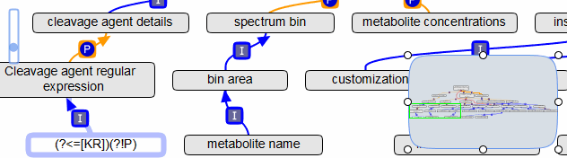
Example: old nmrCV
Is a ‘bin area’ a ‘spectrum bin’ ?
→ Taxonomic error, use part_of ?
Is a ‘metabolite name’ a ‘spectrum bin’ ?
→ Use-mention error, use is_proxy_for ?

Slide 25
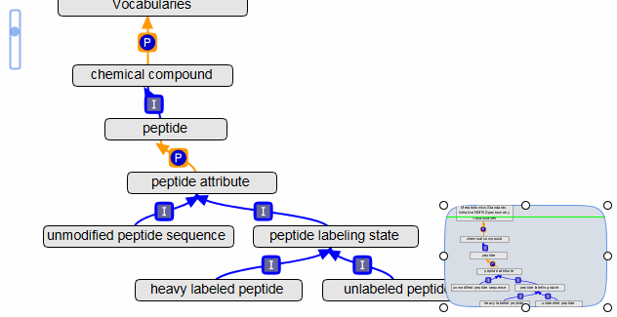
Example: PSI msCV
Is a ‘peptide’ part_of a ‘vocabulary’ ?
→ Use-mention error, use TLO
Transitivity: ‘heavy labeled peptide’ part_of ‘peptide’ rather than Is_a ?

Slide 26
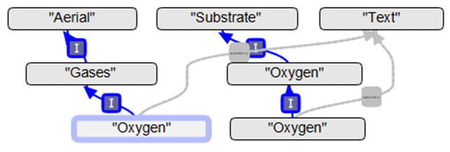
Example: XeoCV
An Oxygen is a Gases ?
→ Plural violation, naming convention violation
Definition: "Defines the concentration of O2 in the air"
→ Not in sync with label and taxonomy
(Another) Oxygen is a Substrate ?
→ Confusion with role
Oxygen has_role Substrate
Multiple occurrences of classes with same name
→ Redundancy errors

